Slide 1
Customer Segmentation Analysis
Oasis Infobyte – Data Analytics Internship
Level 1 – Task 2
Intern:- Nandini Dolas
Tools:- Python, Pandas, Matplotlib, Seaborn, Scikit- Learn

Slide 2
Project Overview and Dataset
Objective
Identify customer groups based on annual income and spending behavior.
Understand customer purchasing patterns.
Develop useful marketing recommendations.
Dataset Overview
Dataset: Mall_Customers.csv
Total Records: 200 customers
Total Columns: 5
Features: Customer ID, Gender, Age, Annual Income, Spending Score

Slide 3
Analysis
Data Loading: Imported the dataset using Pandas.
Data Exploration: Examined data types, summary statistics, and distributions.
Data Visualization: Created histograms and scatter plots.
Data Preprocessing: Standardized annual income and spending score.
Optimal Clusters: Used the Elbow Method to select the number of clusters.
Clustering: Applied K-Means with 5 clusters.
Interpretation: Examined cluster profiles and developed recommendations.

Slide 4
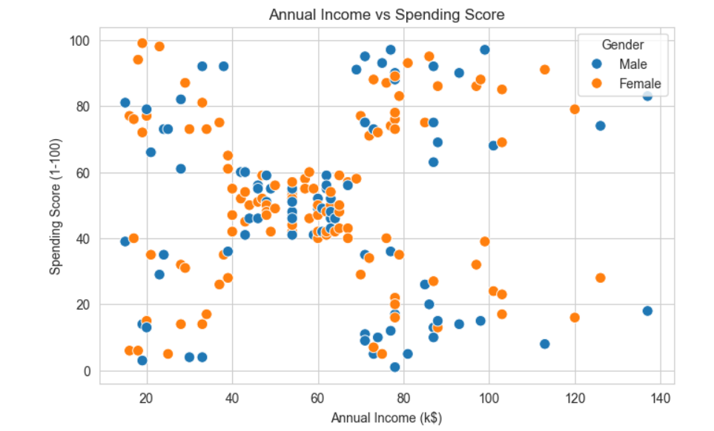
Exploratory Data Analysis
Analysis Performed
Studied customer age distribution.
Examined annual income distribution.
Analyzed spending score distribution.
Compared annual income and spending score by gender.
Key Observation
Visualizations helped explore customer characteristics and identify patterns that could be useful for customer segmentation.

Slide 5
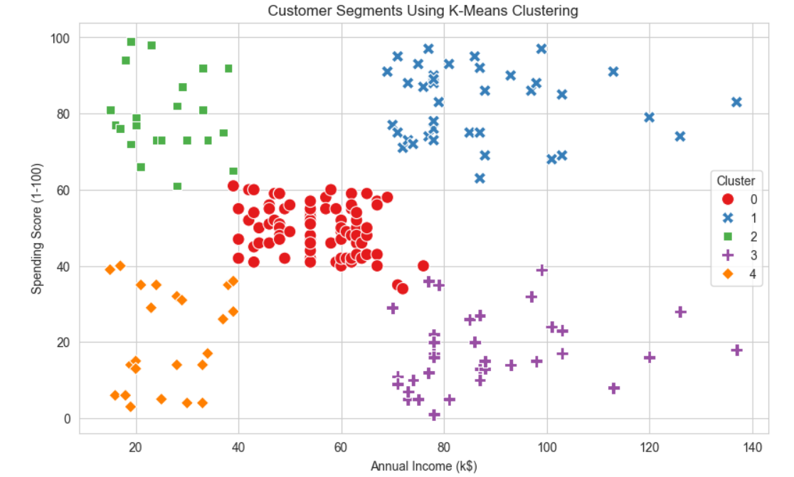
K-Means Customer Segmentation
Method Used: K-Means Clustering
Selected annual income and spending score as clustering features.
Standardized the selected features using StandardScaler.
Used the Elbow Method to help choose the number of clusters.
Applied K-Means with 5 clusters.
Visualized the resulting customer groups.
Purpose: Group customers with similar income and spending characteristics.

Slide 6
Business Recommendations
High-Spending Customers: Think about loyalty programs and personal offers.
Prospective Growth Customers: Experiment with promotions and recommendations for products.
Low-Spending Customers: Investigate customers' requirements and preferences to find possible areas of work.
Marketing Campaigns: Create marketing campaigns tailored to the particularities of each segment.
Constant Observation: Analyze the behavior of customers to justify the segmentation.
Please note that the recommendations must be related to the particularities of each segment.

Slide 7
Conclusion
Explored customer demographics, annual income, and spending behavior.
Used data visualization to understand customer patterns.
Applied K-Means clustering to create five customer groups.
Identified opportunities for more targeted marketing strategies.
Conclusion: Customer segmentation helps businesses better understand customer behavior and make informed marketing decisions.
THANK YOU!
Oasis Infobyte — Data Analytics Internship

